Slide 1

Solar Power Generation Prediction Using Machine Learning with Weather-Based Feature Analysis
INDIVIDUAL PROJECT PRESENTATION
[Student Name] | Roll No. [Roll Number]
[Department] · [Institution]
Academic Year [20XX–20XX]
Dataset: Indian Solar Power Generation Data (Kaggle), Plant 1
Notes:
Good morning/afternoon. My project is 'Solar Power Generation Prediction Using Machine Learning with Weather-Based Feature Analysis'. I used real data from one solar plant in India to test how well weather and time information can estimate the plant's AC power output. I will walk through the data, the method following the KDD workflow, the results, and the limitations. (Introduce yourself with your name, roll number, department and institution.)

Slide 2


Introduction: Why Predict Solar Power?
Solar is a key renewable source
Output depends on the weather
Predictive analytics helps
Photovoltaic plants convert sunlight directly into electricity without burning fuel.
Irradiation and temperature change through the day, so plant power output keeps changing.
Machine learning learns the weather-to-power relationship from historical plant data.
Guiding question: how accurately can weather and time features estimate plant-level AC power?
Notes:
Solar energy is an important renewable source, but a plant's output is not constant because it depends on weather conditions such as sunlight and temperature. Predictive analytics lets us learn that relationship from past data. This leads to the guiding question of the project: how accurately can weather and time features estimate the plant's AC power output?

Slide 3

Problem Statement and Objectives
1
Build a clean plant-level dataset
WHAT IS PREDICTED
Combine Plant 1 generation and weather data.
Total plant-level AC power output (AC_POWER, kW)
2
Compare three regression models
Linear Regression, Random Forest, Gradient Boosting.
WHY
To understand how measured weather and time of day relate to generated power.
3
Evaluate fairly over time
Chronological 80:20 split; MAE, RMSE and R².
Same-timestamp estimation, not future forecasting
4
Interpret the results
Actual vs predicted, residuals, feature importance.
Notes:
The target is the total AC power of the plant in kilowatts at each timestamp. The reason is to understand how weather and time of day drive generation. Importantly, this is same-timestamp estimation using measured weather, not forecasting the future. My four objectives are on the right: build a clean dataset, compare three models, evaluate them fairly using a chronological split, and interpret the results.

Slide 4

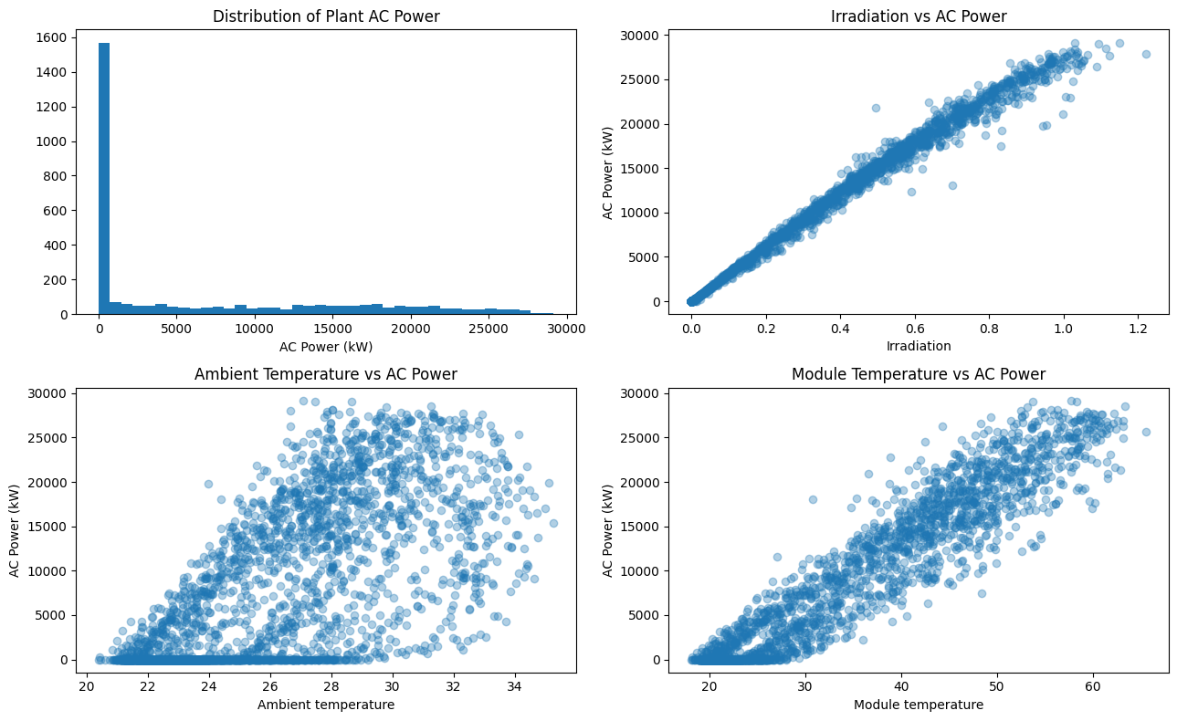
Dataset Description
68,778
3,182
34 days
15 min
generation rows (7 columns)
weather rows (6 columns)
15 May – 17 Jun 2020
reading interval
Plant_1_Generation_Data.csv (inverter-level)
DATE_TIME
PLANT_ID
SOURCE_KEY
DC_POWER
AC_POWER
DAILY_YIELD
TOTAL_YIELD
Plant_1_Weather_Sensor_Data.csv
DATE_TIME
PLANT_ID
SOURCE_KEY
AMBIENT_TEMPERATURE
MODULE_TEMPERATURE
IRRADIATION
Target
Model input / time source
Not an input
Source: Kaggle — Indian Solar Power Generation Data (Plant 1 files only)
Notes:
The data comes from the public Kaggle dataset 'Indian Solar Power Generation Data'. I used Plant 1 only, with two files: inverter-level generation data with 68,778 rows, and weather sensor data with 3,182 rows. Readings are every 15 minutes from 15 May to 17 June 2020, about 34 days. The green chip is my target, AC_POWER; light-green chips are the inputs or the source of time features; grey columns are not used as inputs. The exploration plot on the right already shows that AC power rises almost linearly with irradiation.

Slide 5





Data Understanding and Preprocessing
1 Validate
2 Parse
3 Aggregate
4 Merge
Missing values: 0 in every column of both files.
Duplicate rows: 0 in both files.
DATE_TIME converted to datetime; power and weather columns coerced to numeric.
AC_POWER summed across inverters per timestamp. Weather averaged per timestamp.
Inner join on PLANT_ID + DATE_TIME, validated one-to-one.
ROW COUNT THROUGH THE PIPELINE
68,778
inverter-level generation rows
3,158
plant-level timestamps
3,157
merged rows used for modelling
Notes:
First I checked data quality: there were no missing values and no duplicate rows in either file. Then I parsed the timestamps into datetime format. The generation file has one row per inverter per timestamp, so I summed AC power across inverters to get plant-level output, giving 3,158 timestamps; weather readings were averaged per timestamp. Finally I merged the two tables with an inner join on plant and timestamp, which left 3,157 rows for modelling.

Slide 6




KDD Workflow
1
2
3
4
5
6
7
Data Selection
Data Understanding
Pre-processing
Transformation
Modelling
Evaluation
Interpretation
Plant 1 generation and weather files
Columns, types, missing values, duplicates
Parse timestamps, aggregate inverters, merge weather
Create HOUR, MINUTE, DAY_OF_WEEK; define features
Linear Regression, Random Forest, Gradient Boosting
Chronological 80:20 split; MAE, RMSE, R²
Compare models; plots; feature importance
Data preparation (stages 1–4)
Modelling and evaluation (5–6)
Knowledge (7)
Outcome: knowledge of how weather and time features relate to plant AC power
Notes:
The whole project follows the Knowledge Discovery in Databases, or KDD, workflow. Stages one to four prepare the data: selection, understanding, pre-processing and transformation. Stages five and six are modelling and evaluation. Stage seven, interpretation, turns the results into knowledge about which weather factors matter. The notebook is organised in exactly this order.

Slide 7

Features and Predictive Modelling
TARGET
THREE REGRESSION ALGORITHMS
AC_POWER
Total plant-level AC power (kW)
Linear Regression
1
INPUT FEATURES (6)
Median imputer → StandardScaler → LinearRegression
IRRADIATION
AMBIENT_TEMPERATURE
MODULE_TEMPERATURE
HOUR
MINUTE
DAY_OF_WEEK
Random Forest
2
200 trees, min_samples_leaf = 2, random_state = 42
Leakage prevention
Gradient Boosting
Excluded from inputs: DC_POWER, DAILY_YIELD, TOTAL_YIELD, SOURCE_KEY.
3
150 estimators, learning_rate = 0.05, max_depth = 3, random_state = 42
Notes:
The target is AC_POWER. The six inputs are three weather measurements — irradiation, ambient temperature and module temperature — plus three time features extracted from the timestamp: hour, minute and day of week. To prevent leakage, I excluded other generation readings such as DC_POWER, DAILY_YIELD and TOTAL_YIELD, because they are too closely tied to the output itself. I compared three regression algorithms in scikit-learn pipelines: Linear Regression as a simple baseline, and Random Forest and Gradient Boosting as tree-based ensembles. The settings are shown on the cards, and random state 42 keeps results reproducible.

Slide 8
Evaluation Methodology
CHRONOLOGICAL 80:20 SPLIT (NO SHUFFLING)
Training: 2,525 rows (80%)
Test: 632 (20%)
15 May 2020 00:00 → 11 Jun 2020 09:15
11 Jun 09:30 → 17 Jun 23:45
MAE
RMSE
R²
Mean Absolute Error
Root Mean Squared Error
Coefficient of determination
average of |actual − predicted|
√ of the average squared error
1 − SSresidual / SStotal
Lower is better (kW)
Penalises large errors; lower is better (kW)
Share of variance explained; closer to 1 is better
Notes:
Because the data is a time series, I did not shuffle it. The first 80 percent of the timeline — 2,525 rows from 15 May to 11 June — is used for training, and the final 20 percent — 632 rows from 11 to 17 June — is held out for testing. The models are scored with three metrics. MAE is the average absolute error in kilowatts. RMSE squares the errors first, so it penalises large mistakes more. R-squared is the share of variance in AC power that the model explains. The best model is selected by lowest test RMSE.

Slide 9
Results and Model Comparison
Best model by test RMSE: Gradient Boosting (480.0973 kW)
Model | MAE (kW) | RMSE (kW) | R²
Gradient Boosting | 244.8238 | 480.0973 | 0.9964
Random Forest | 238.9281 | 490.4442 | 0.9962
Linear Regression | 502.6576 | 806.3010 | 0.9898
Random Forest has the lowest MAE (238.9281 kW), but Gradient Boosting has the lower RMSE.
Linear Regression has the highest errors, yet its R² is still 0.9898.
Notes:
This table shows the actual test-set results from the notebook. Gradient Boosting is the best model by test RMSE: 480.0973 kW, with MAE 244.8238 kW and R-squared 0.9964. Random Forest is very close, with RMSE 490.4442 and R-squared 0.9962, and it actually has the slightly lower MAE of 238.9281. Linear Regression has roughly double the MAE and a clearly higher RMSE of 806.3010, but its R-squared of 0.9898 shows that even a linear model captures most of the relationship. The chart on the right makes the gap between the tree ensembles and the linear baseline visible.

Slide 10

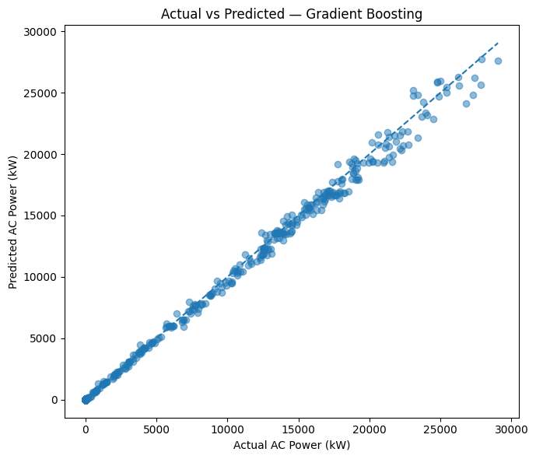
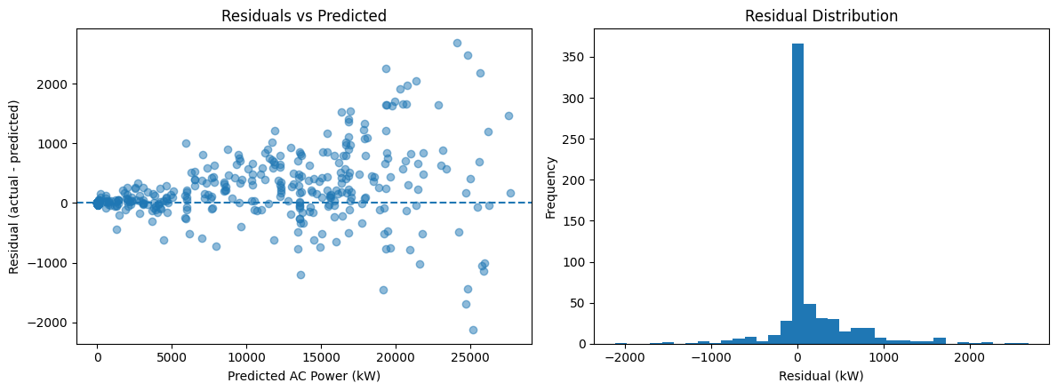
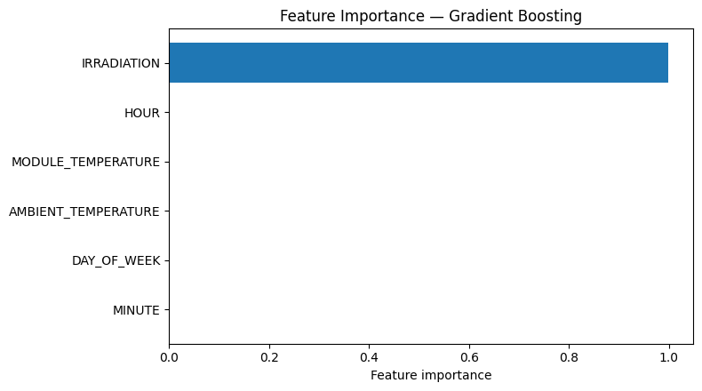
Interpretation and Discussion
Actual vs predicted: points follow the 1:1 line closely across the full power range.
Residuals: most are near zero; spread grows at higher predicted power.
Feature importance: IRRADIATION 0.998540; HOUR 0.000511 is next. Importance shows usefulness, not causation.
Notes:
These plots are all from the notebook, for the best model, Gradient Boosting. Top left: predicted values lie very close to the diagonal line, so the model tracks actual output well. Top right: residuals, meaning actual minus predicted, are concentrated around zero, but the errors get larger when the plant is producing more power. Bottom left: feature importance is overwhelmingly dominated by irradiation at 0.9985; hour, module temperature and ambient temperature contribute very little. Remember that feature importance tells us what the model finds useful for prediction, not what causes the output.

Slide 11


Conclusion and Limitations
Main findings
Limitations
Gradient Boosting gave the lowest test RMSE: 480.0973 kW (R² = 0.9964).
!
Short observation period: about 34 days (15 May – 17 Jun 2020).
!
Single-plant scope: Plant 1 only.
Both tree ensembles beat Linear Regression (RMSE 806.3010 kW).
!
Same-timestamp estimation with measured weather, not forecasting.
IRRADIATION dominated feature importance (0.998540).
!
Feature importance is not causation.
Next steps: longer, multi-plant data and genuine forecasting using weather forecasts
Notes:
To conclude: Gradient Boosting performed best by test RMSE, with 480.0973 kW and an R-squared of 0.9964, and both tree-based models clearly beat Linear Regression. Irradiation is by far the most useful input. However, there are limitations. The data covers only about 34 days, from a single plant, so results may not generalise to other seasons or sites. The task is same-timestamp estimation using measured weather — it is not forecasting the future. And feature importance describes predictive usefulness, not causation. Natural next steps are longer, multi-plant data and true forecasting using weather forecasts.

Slide 12

References and Q&A
Kannal, A. Solar Power Generation Data (Plant 1). Kaggle. kaggle.com/datasets/anikannal/solar-power-generation-data
Fayyad, U., Piatetsky-Shapiro, G., & Smyth, P. (1996). From data mining to knowledge discovery in databases. AI Magazine, 17(3), 37–54.
Pedregosa, F. et al. (2011). Scikit-learn: Machine learning in Python. Journal of Machine Learning Research, 12, 2825–2830.
Breiman, L. (2001). Random forests. Machine Learning, 45(1), 5–32.
Friedman, J. H. (2001). Greedy function approximation: A gradient boosting machine. Annals of Statistics, 29(5), 1189–1232.
Antonanzas, J. et al. (2016). Review of photovoltaic power forecasting. Solar Energy, 136, 78–111.
Questions?
Thank you for listening
Notes:
These are the sources used: the Kaggle dataset, the original KDD paper, the scikit-learn library paper, the original papers for Random Forest and Gradient Boosting, and a review of photovoltaic power forecasting. Thank you for listening — I would be happy to take any questions. (Likely questions: why a chronological split instead of a random split; why DC_POWER was excluded; whether the model can forecast tomorrow's output — it cannot, because it uses measured same-timestamp weather.)

